Slide 1
Using TCGA breast cancer MongoDB dataset combined with R shiny
Cheng-Hsiang Lu
Course: TRGN516
Instructor: Dr. Enrique
Notes:
Hi Everyone, My name is Sam.
Today, the topic I’m going to talk about is:
“Using TCGA breast cancer MongoDB dataset combine with R shiny”

Slide 2
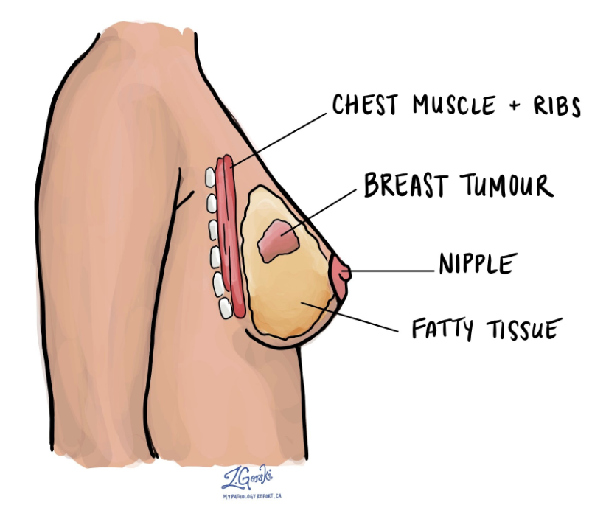
Breast cancer
Malignant tumors that develop from cells found in the breast
The second leading cause of cancer death in women
Breast cancer occurs mainly in women
13% of woman develop breast cancer in US
Age: 50 years old or older
1. American Cancer Society, I. American Cancer Society, Inc website. 2022 [cited 2022 April 26]; Available from: https://www.cancer.org/cancer/breast-cancer/about/how-common-is-breast-cancer.html#:~:text=Overall%2C%20the%20average%20risk%20of,will%20never%20have%20the%20disease.
2. American Cancer Society, I. American Cancer Society, Inc website. 2022 [cited 2022 April 26]; Available from: https://www.cancer.org/cancer/breast-cancer/about/what-is-breast-cancer.html.
Notes:
First, let’s talk about breast cancer.
Breast cancer is a term used to describe a group of malignant tumors that develop from cells normally found in the breast
A malignant tumor is made up of abnormal cells that have the ability to invade surrounding tissues and spread to other parts of the body
And breast cancer is the second leading cause of cancer death in women
It occurs almost entirely in women, but men can get breast cancer, too
Overall, the average risk of a woman in the United States developing breast cancer in her life is about 13%
This means there is a 1 in 8 chance she will develop breast cancer
Last but not least, most breast cancers are found in women who are 50 years old or older

Slide 3
Goal
Study the highly expressed SNP in early stage breast cancer patients over 50 years old post-menopausal women.
Notes:
The goal of this final project is to
Study the highly expressed SNP in early stage breast cancer patients over 50 years old post-menopausal women.

Slide 4

MongoDB
A NoSQL database
Handle large volumes of data
High speed
Scalable and flexible
Query and Index
JSON-like documents
Free
3. MongoDB, I. MongoDB, Inc website. 2022 [cited 2022 April 26]; Available from: https://www.mongodb.com/what-is-mongodb.
Notes:
Before exploring my dataset, I’m going to talk about why I choose to use MongoDB
MongoDB is a Nosql database
It can handle large volumes of data at high speed
MongoDB has the scalability and flexibility that you want
And the querying and indexing that you need
It is simple for developers to learn and use, while still providing all the capabilities needed to meet the most complex requirements at any scale.
MongoDB stores data in JSON-like documents, meaning fields can vary from document to document and data structure can be changed over time
And last, MongoDB is free to use.

Slide 5
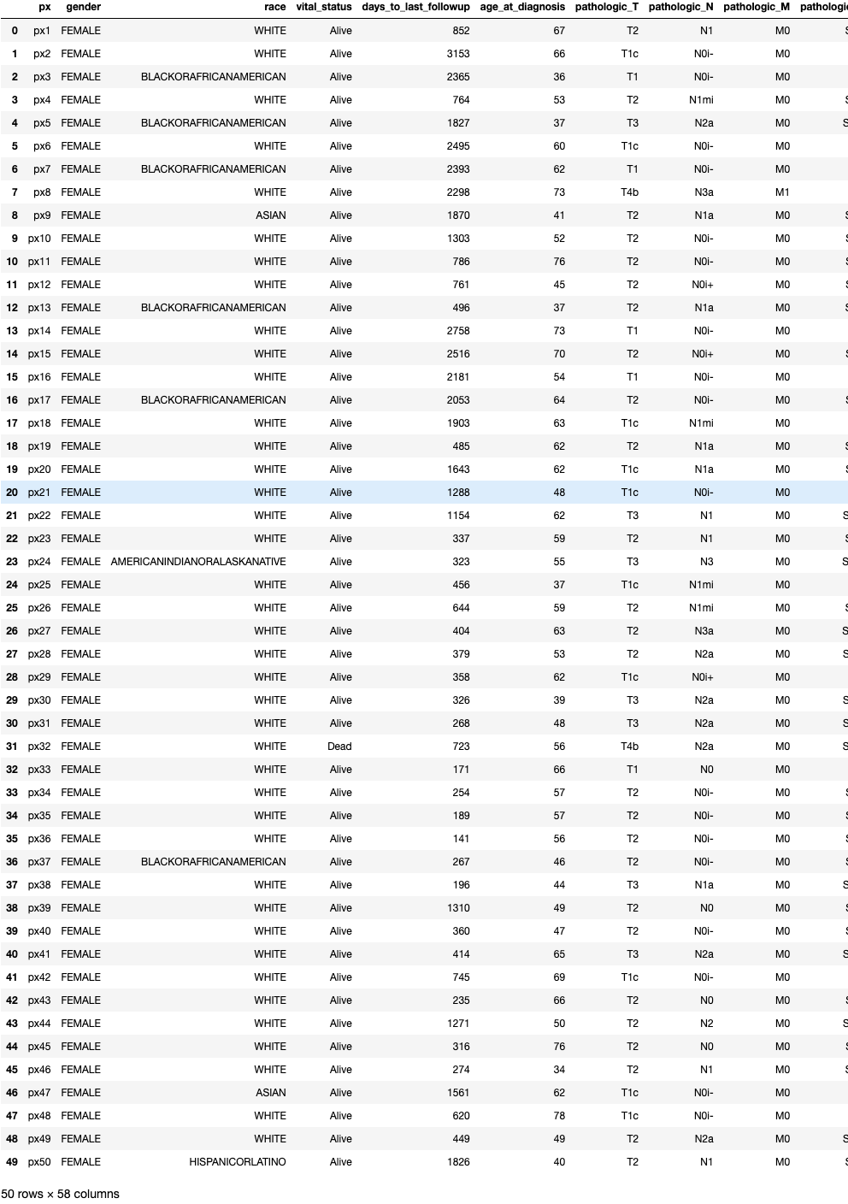
Dataset
TCGA dataset breast cancer
50 samples and 57 columns
Notes:
First, My dataset is from TCGA
it contains 50 breast cancer patients and 57 columns

Slide 6
Columns
px
gender
Race
vital_status
days_to_last_followup
age_at_diagnosis
pathologic_T, pathologic_N, pathologic_M
pathologic_stage
surgical_procedure_first
drug_name_1 to 8
radiation_type_1
anatomic_treatment_site_1
Pathogenic_Chr_Pos_1 to 18
Exon_1_RPKM_1 to 18
Notes:
Columns include: px as patient’s number, gender, race
vital_status, days_to_last_followup, age_at_diagnosis
pathologic_stage, surgical_procedure, drug_name
radiation_type, anatomic_treatment_site
Pathogenic_Chr_Pos and Exon_RPKM

Slide 7
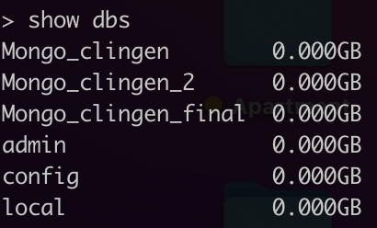
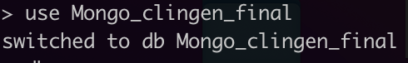
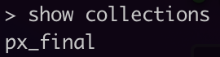
Dataset
Create a database
Mongo_clingen_final
Import dataset
px_final.json
Start making queries
Notes:
First, for this final project, we create a database called Mongo_clingen_final
Then, open a new terminal and use mongoimport to import my dataset px_final.json
After importing my dataset, we can start making queries.

Slide 8

#Query 1
Most breast cancers are found in women who are 50 years old or older
34 out of 50 samples are older than 50 years old
4. Centers for Disease Control and Prevention. CDC website. 2021 [cited 2022 April 26]; Available from: https://www.cdc.gov/cancer/breast/basic_info/risk_factors.htm#:~:text=Most%20breast%20cancers%20are%20found,factors%20have%20the%20same%20effect.
Notes:
In order to reach my goal step by step, the first query I would like to make is
to see how many women in all races are older than 50 years old in the dataset
Due to the article I found
mentions that most breast cancers are found in women who are 50 years old or older.
And it shows that there are 34 women are older than 50 years old.

Slide 9
#Query 2
Arimidex is used to treat post-menopausal women
The average age of menopause range from 45 and 55
12 patients within my first query use Arimidex as their first drug
5. Breastcancer.org. Breastcancer.org website. 2022 [cited 2022 April 26]; Available from: https://www.breastcancer.org/treatment/hormonal-therapy/arimidex.
6. University of Utah. University of Utah website. 2022 [cited 2022 April 26]; Available from: https://healthcare.utah.edu/womenshealth/gynecology/menopause/postmenopause.php#:~:text=Most%20women%20reach%20this%20milestone%20somewhere%20between%20ages%2045%20and%2055.,-A%20New%20Pause.
7. Sanford, M. and G.L. Plosker, Anastrozole: a review of its use in postmenopausal women with early-stage breast cancer. Drugs, 2008. 68(9): p. 1319-40.
Notes:
The second query I make
is to see how many patients use Arimidex within my first query.
Arimidex is used to treat post-menopausal women diagnosed with either early-stage or advanced-stage, hormone receptor-positive breast cancer.
The average age of menopause range from 45 and 55, so I select the median value 50.
In the end, within my first query, there are 12 patients use Arimidex as their first drug.

Slide 10
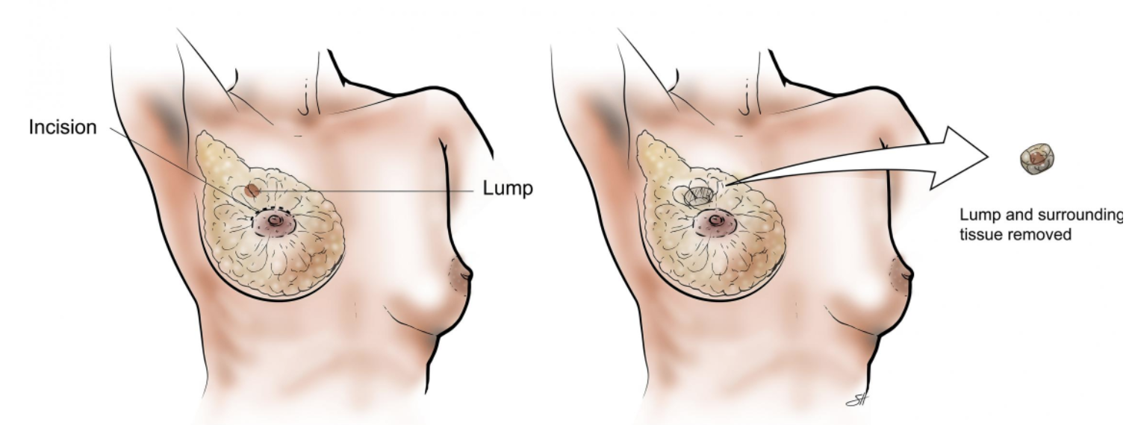
#Query 3
Lumpectomy is one of the common surgery to remove breast cancer.
8. American Cancer Society, I. merican Cancer Society, Inc. website. 2022 [cited 2022 April 26]; Available from: https://www.cancer.org/cancer/breast-cancer/treatment/surgery-for-breast-cancer.html#:~:text=This%20surgery%20is%20also%20called,several%20different%20types%20of%20mastectomies.
9. Baylor College of Medicine. Baylor College of Medicine website. 1998-2021 [cited 2022 April 26]; Available from: https://www.bcm.edu/healthcare/specialties/oncology/cancer-types/breast-cancer/breast-cancer-surgery/lumpectomy.
Notes:
Then, continue with the second query,
I would like to know how many people’s first surgical procedure are Lumpectomy.
Lumpectomy is one of the common surgery to remove breast cancer.
You can see from the figure below.
it is a surgery to remove the cancer as well as some surrounding normal tissue.
How much breast is removed depends on where and how big the tumor is.
So, there are only 9 patients go through Lumpectomy after my second query.

Slide 11
#Query 4
Early stage of StageIA and StageIB
Stage1A:
Small
Invasive
Not spread to the lymph nodes
Stage1B:
Spread to the lymph nodes
The cancer in the lymph node is larger than 0.2 mm but less than 2 mm in size.
3 patients fit the query.
10. American Society of Clinical Oncology. ASCO website. 2005-2022 [cited 2022 April 26]; Available from: https://www.cancer.net/cancer-types/breast-cancer/stages.
Notes:
Within these 9 patients,
I want to check how many patients are in the early stage of breast cancer
For example, StageIA and StageIB
When the tumor is small, invasive, and has not spread to the lymph nodes
It is stage as Stage IA
When the cancer has spread to the lymph nodes and the cancer in the lymph node is larger than 0.2 mm but less than 2 mm in size.
It is stage as Stage IB
As the result, There are 3 patients fit the query.

Slide 12
#Query 5
Check Pathogenic_Chr_Pos_1 which is “13_32903685” or “13_32890572” reported as highly expressed
Only 1 patient fit the query.
11. National Library of Medicine. ClinVar. 2022 [cited 2022 April 26]; Available from: https://www.ncbi.nlm.nih.gov/clinvar/variation/126192/?new_evidence=true.
12. National Library of Medicine. ClinVar. 2015 [cited 2022 April 26]; Available from: https://www.ncbi.nlm.nih.gov/clinvar/variation/125965/?new_evidence=true.
Notes:
For the last query,
I would like to check how many of these 3 patients have the specific pathogenic Chromosome Position 1
which is “13_32903685” or “13_32890572” reported as highly expressed.
It turns out that only one of them fit the query.
And it’s highly expressed pathogenic Chromosome Position 1 is “13_32890572”
Then lets take a look at this position.
Capalbo C, Ricevuto E, Vestri A, Ristori E, Sidoni T, Buffone O, Adamo B, Cortesi E, Marchetti P, Scambia G, Tomao S, Rinaldi C, Zani M, Ferraro S, Frati L, Screpanti I, Gulino A, Giannini G. BRCA1 and BRCA2 genetic testing in Italian breast and/or ovarian cancer families: mutation spectrum and prevalence and analysis of mutation prediction models. Ann Oncol. 2006 Jun;17 Suppl 7:vii34-40. doi: 10.1093/annonc/mdl947. PMID: 16760289.

Slide 13
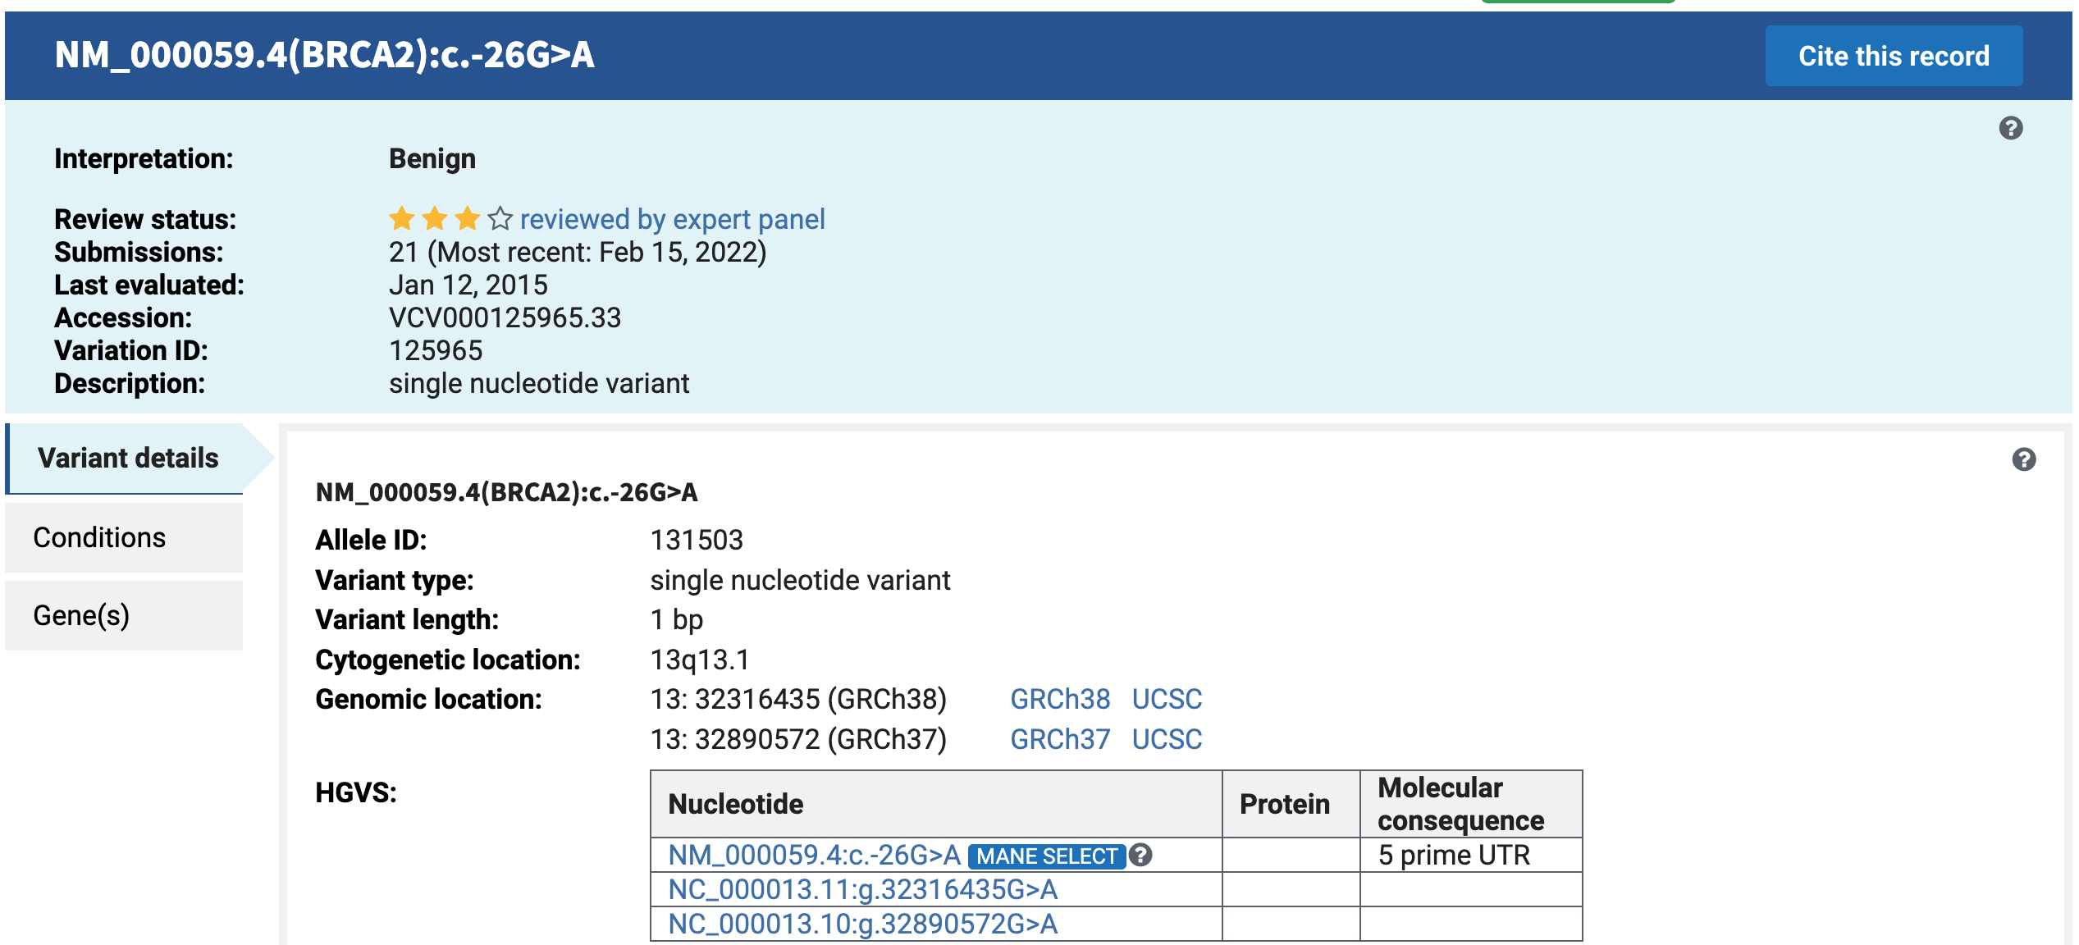
Pathogenic_Chr_Pos_1 “13_32890572”
13: 32890572 (GRCh37)
Single nucleotide variant
G>A
BRCA2
Benign
13. Capalbo, C., et al., BRCA1 and BRCA2 genetic testing in Italian breast and/or ovarian cancer families: mutation spectrum and prevalence and analysis of mutation prediction models. Ann Oncol, 2006. 17 Suppl 7: p. vii34-40.
Notes:
It’s genomic location is in Chormosome 13 position 32890572 in GRCh37
It’s a single nucleotide variant.
a G to A mutation
Related with BRCA2
And it is interpreted as Benign
So, it is in line with my former queries about the drug usage, first surgery, and the early stage.

Slide 14
Conclusion
The highly expressed SNP position 32890572 in Chromosome 13 is interpret as Benign.
We can also speculate the result from their drug usage and surgical procedure.
Notes:
From this study, we first select patients in all races who are older than 50 years old
Second, we make query of their first drug Arimidex
Third, we make query of their first surgical procedure which is Lumpectomy
Then, we narrow down our query with early stage
Last, we make query of their highly expressed pathogenic Chromosome Position
we can conclude that the highly expressed SNP position 32890572 in Chromosome 13 is interpret as Benign.
We can also speculate the result from their drug usage and surgical procedure.

Slide 15
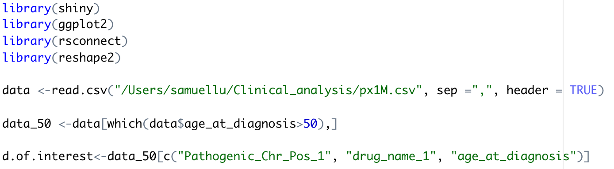
R shiny
Libraries:
shiny
ggplot2
rsconnect
reshape2
Only keep patients who >=50 years old
Select three colums:
Pathogenic_Chr_Pos_1
Drug_name_1
Age_at_diagnosis
Notes:
Then, I use R shiny to display my graphs
First, I use labraries of shiny, ggplot2, reconnect, and reshape2
Second, I only keep patients who are greater than 50 years old
This time, I select three columns which are Pathogenic_Chr_Pos_1, Drug_name_1, and Age_at_diagnosis from my former queries.

Slide 16
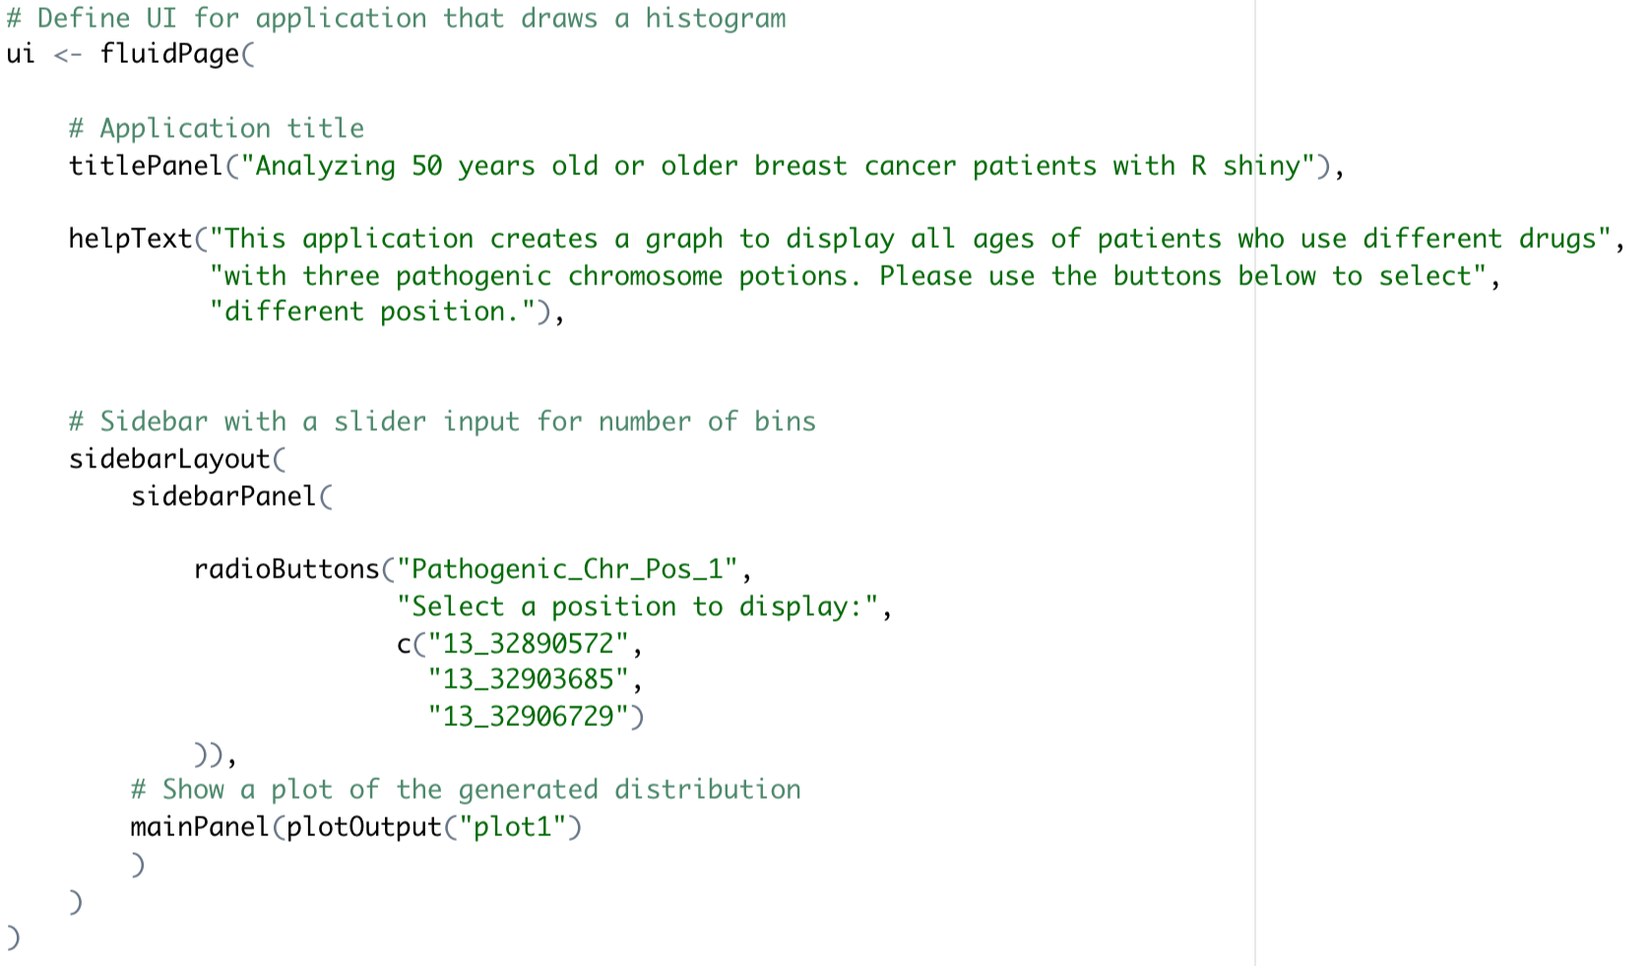
R shiny
User Interface (ui)
Title
Text
Sidebar
Notes:
In user interface, I change my title, text, and sidebar buttons with three different positions which are “13_32890572”, “13_32903685”, and “13_32906729”

Slide 17
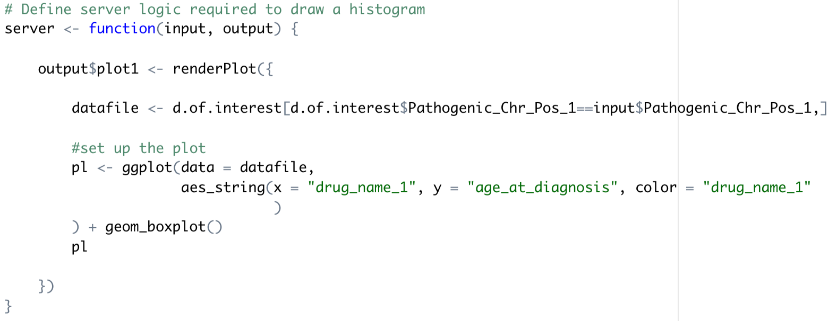
R shiny
Server function (server)
Notes:
In server function, I link my selected columns to be put in the right place of my graph.

Slide 18
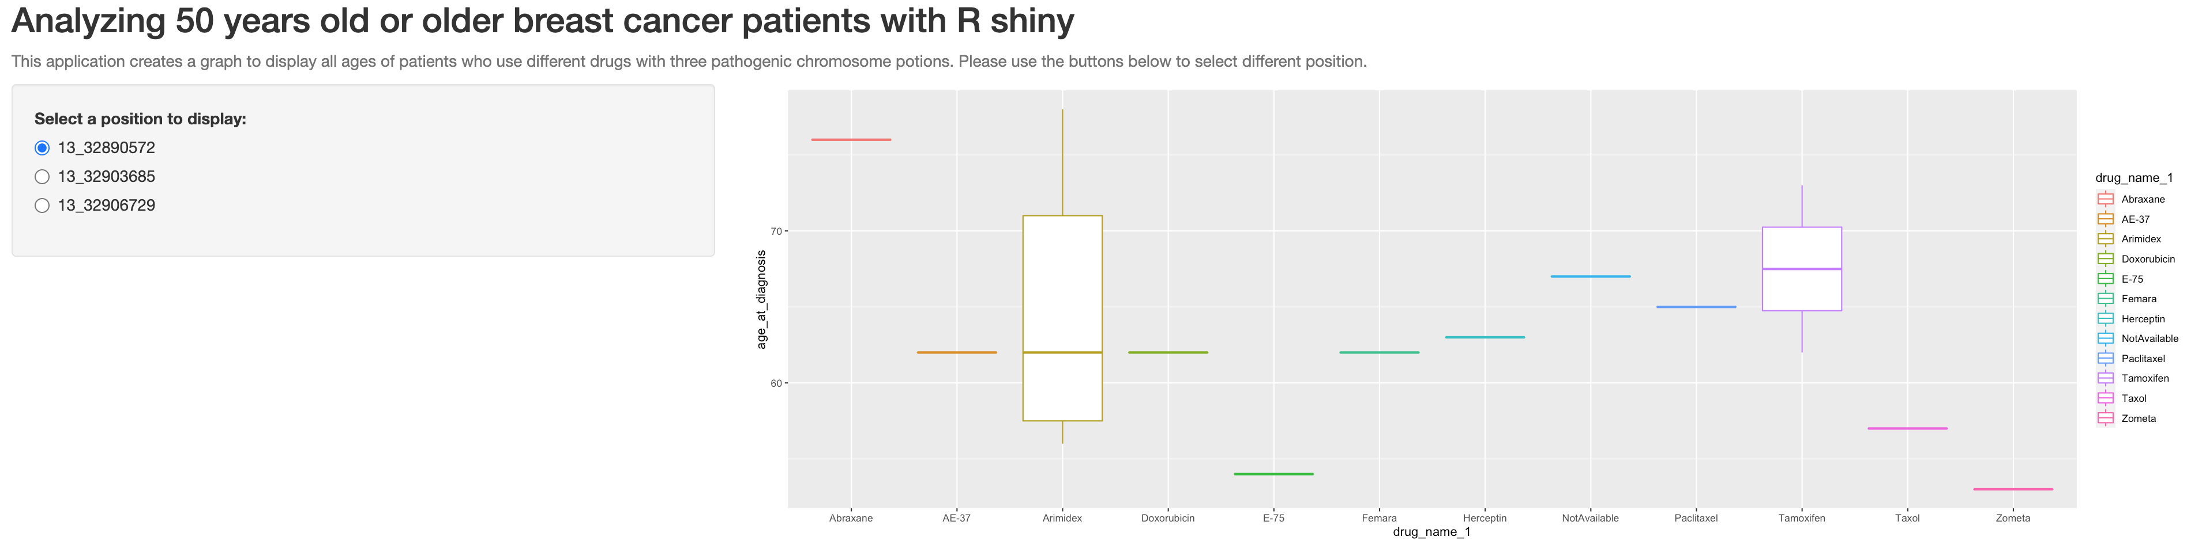
Output
Notes:
In the first output, I select position end with 572,
Most of patients who are older than 50 years old mainly use Arimidex as their first drug in my dataset
And the second large portion of people use Tamoxifen.
#Tamoxifen is used to treat breast cancer that has spread to other parts of the body (metastatic breast cancer), to treat breast cancer in certain patients after surgery and radiation therapy, and to reduce the chances of breast cancer in high-risk patients.

Slide 19
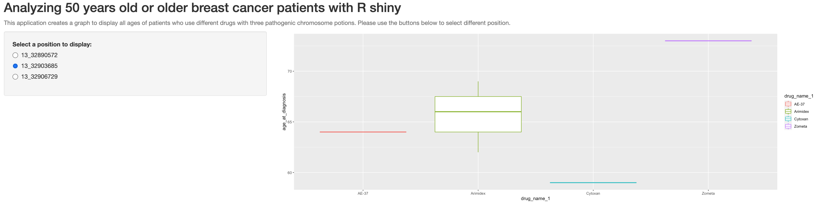
Output
Notes:
In the second output, I select position end with 685,
Still the majority of people use Arimidex as their first drug.

Slide 20
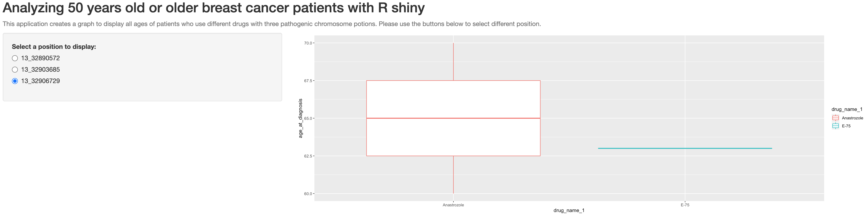
Output
Notes:
With the position end with 729,
Most people use Anastrozole as their first drug.
Anastrozole is used to treat early hormone receptor-positive breast cancer.
And Arimidex is the brand name for anastrozole.

Slide 21
Reference
American Cancer Society, I. American Cancer Society, Inc website. 2022 [cited 2022 April 26]; Available from: https://www.cancer.org/cancer/breast-cancer/about/how-common-is-breast-cancer.html#:~:text=Overall%2C%20the%20average%20risk%20of,will%20never%20have%20the%20disease.
American Cancer Society, I. American Cancer Society, Inc website. 2022 [cited 2022 April 26]; Available from: https://www.cancer.org/cancer/breast-cancer/about/what-is-breast-cancer.html.
MongoDB, I. MongoDB, Inc website. 2022 [cited 2022 April 26]; Available from: https://www.mongodb.com/what-is-mongodb.
Centers for Disease Control and Prevention. CDC website. 2021 [cited 2022 April 26]; Available from: https://www.cdc.gov/cancer/breast/basic_info/risk_factors.htm#:~:text=Most%20breast%20cancers%20are%20found,factors%20have%20the%20same%20effect.
Breastcancer.org. Breastcancer.org website. 2022 [cited 2022 April 26]; Available from: https://www.breastcancer.org/treatment/hormonal-therapy/arimidex.
University of Utah. University of Utah website. 2022 [cited 2022 April 26]; Available from: https://healthcare.utah.edu/womenshealth/gynecology/menopause/postmenopause.php#:~:text=Most%20women%20reach%20this%20milestone%20somewhere%20between%20ages%2045%20and%2055.,-A%20New%20Pause.
Sanford, M. and G.L. Plosker, Anastrozole: a review of its use in postmenopausal women with early-stage breast cancer. Drugs, 2008. 68(9): p. 1319-40.
American Cancer Society, I. merican Cancer Society, Inc. website. 2022 [cited 2022 April 26]; Available from: https://www.cancer.org/cancer/breast-cancer/treatment/surgery-for-breast-cancer.html#:~:text=This%20surgery%20is%20also%20called,several%20different%20types%20of%20mastectomies.
Baylor College of Medicine. Baylor College of Medicine website. 1998-2021 [cited 2022 April 26]; Available from: https://www.bcm.edu/healthcare/specialties/oncology/cancer-types/breast-cancer/breast-cancer-surgery/lumpectomy.
American Society of Clinical Oncology. ASCO website. 2005-2022 [cited 2022 April 26]; Available from: https://www.cancer.net/cancer-types/breast-cancer/stages.
National Library of Medicine. ClinVar. 2022 [cited 2022 April 26]; Available from: https://www.ncbi.nlm.nih.gov/clinvar/variation/126192/?new_evidence=true.
National Library of Medicine. ClinVar. 2015 [cited 2022 April 26]; Available from: https://www.ncbi.nlm.nih.gov/clinvar/variation/125965/?new_evidence=true.
Capalbo, C., et al., BRCA1 and BRCA2 genetic testing in Italian breast and/or ovarian cancer families: mutation spectrum and prevalence and analysis of mutation prediction models. Ann Oncol, 2006. 17 Suppl 7: p. vii34-40.
Notes:
These are our rederences

Slide 22
Thank you.
Notes:
Ok, that’s all for my presentation.
thank you for your listening.

